Slide 1
Unit Testing
Jason Monroe - 688776

Slide 2
Course Objective:
At the end this 60 min session, you will be able to
Write Unit Tests for a React App

Slide 3
Benefits
Must-know for React development
TDD

Slide 4
Key Topics
Testing Rendered Components
Mocking and Spying
Page Actions
Testing Components Connected to Redux
Testing Redux Actions

Slide 5
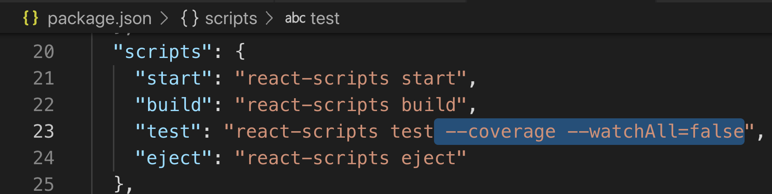
Show Code Coverage

Slide 6
Testing Rendered Components

Slide 7
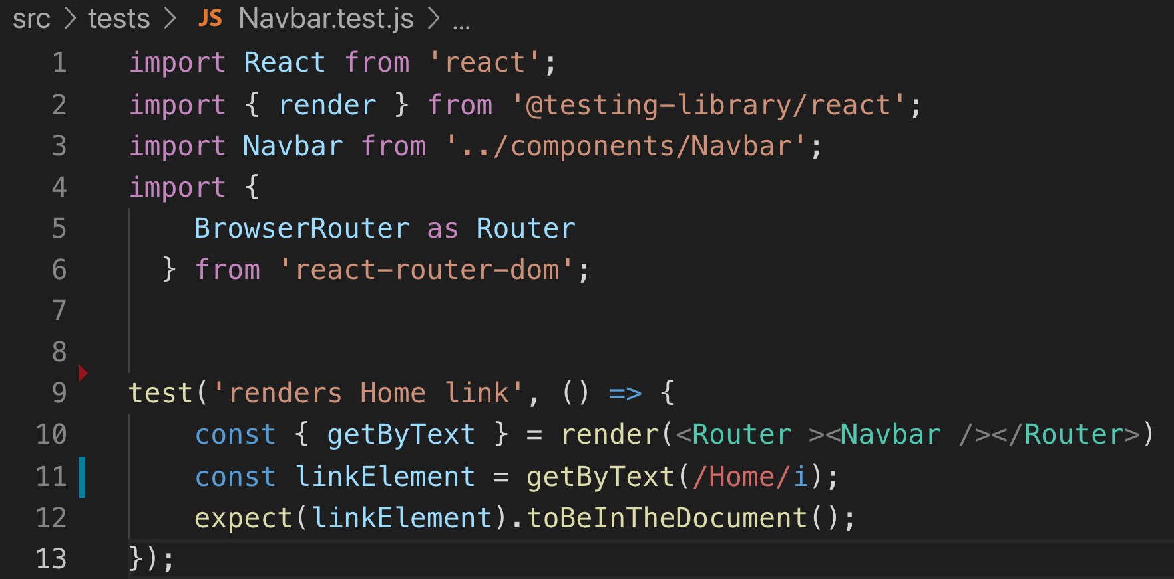
Exists in Document
https://testing-library.com/docs/dom-testing-library/api-queries

Slide 8
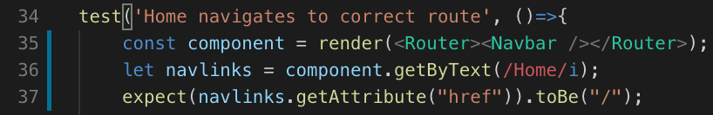
Navigates to Correct Route

Slide 9
Mocking, Spying on Functions

Slide 10
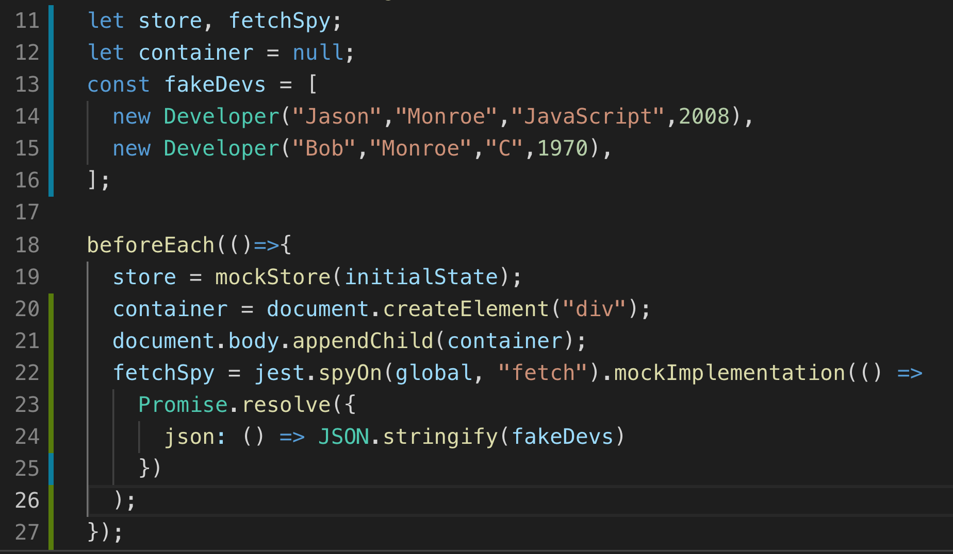
Jest.spyOn
https://reactjs.org/docs/testing-recipes.html

Slide 11
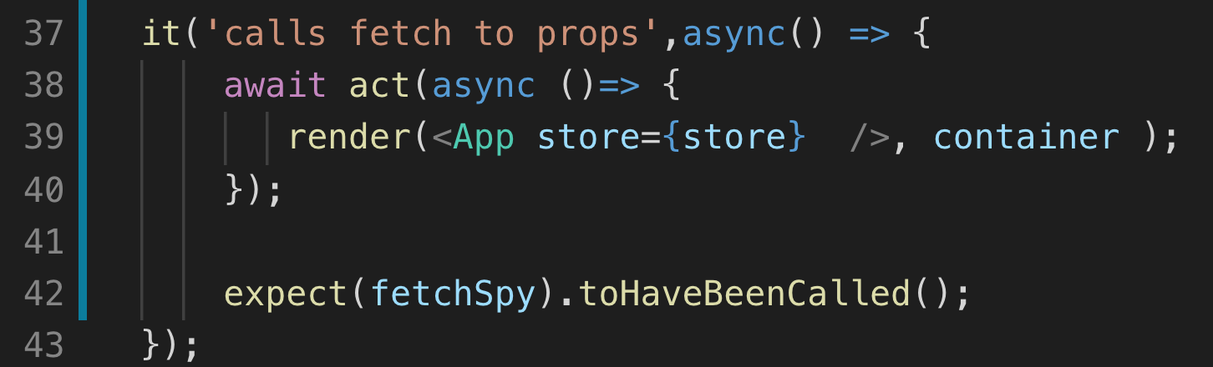
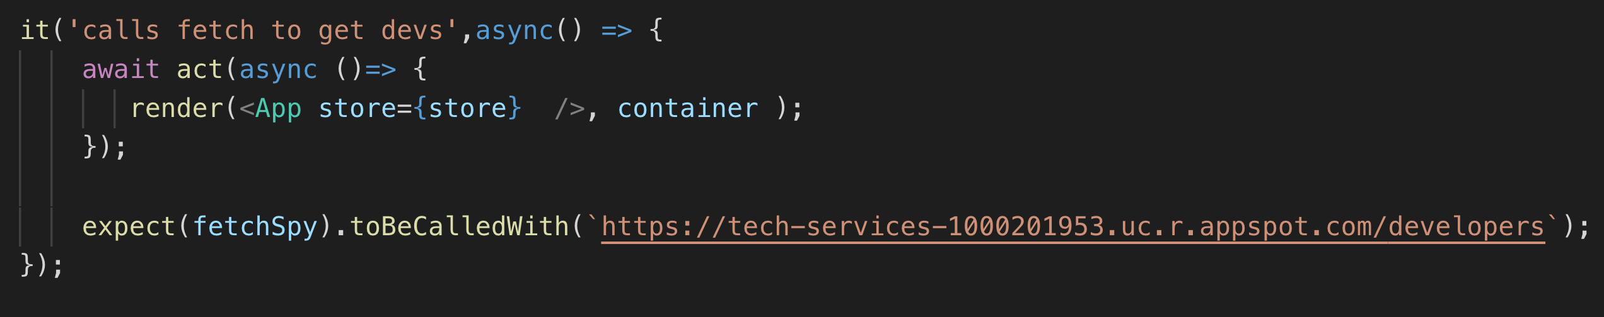
Expect function to be called or called with arguments

Slide 12
Testing Page Actions

Slide 13
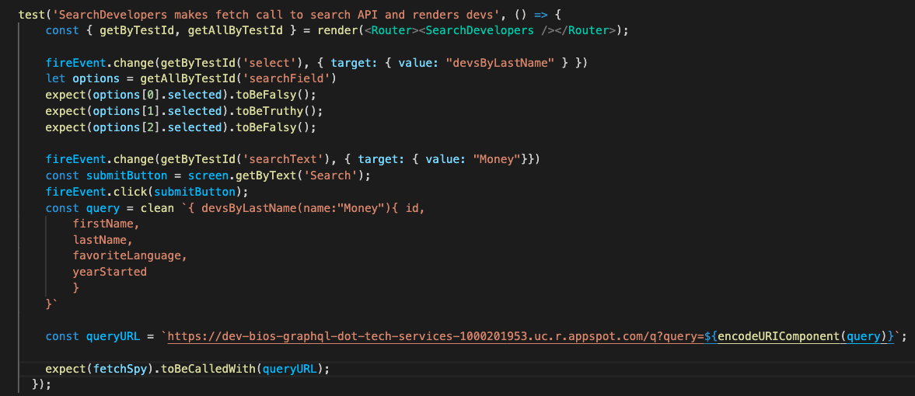
Performing Actions

Slide 14
Testing Components Connected to Redux

Slide 15
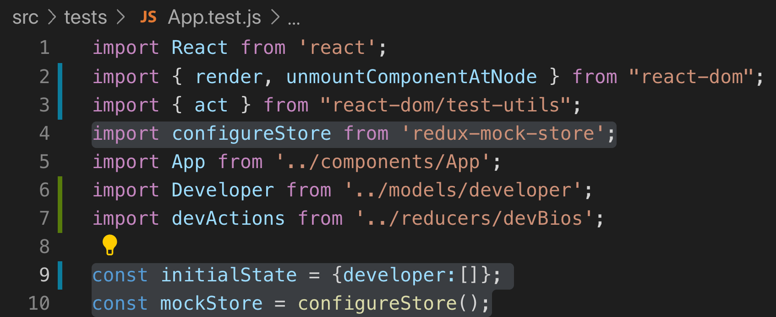
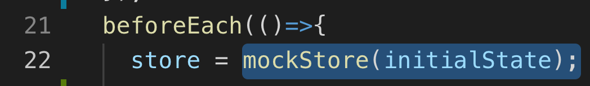
1. Set Up Mock Store
npm install redux-mock-store
https://alligator.io/react/testing-redux-actions/
2. Pass to Component as store prop

Slide 16
Testing Redux Action Creators

Slide 17
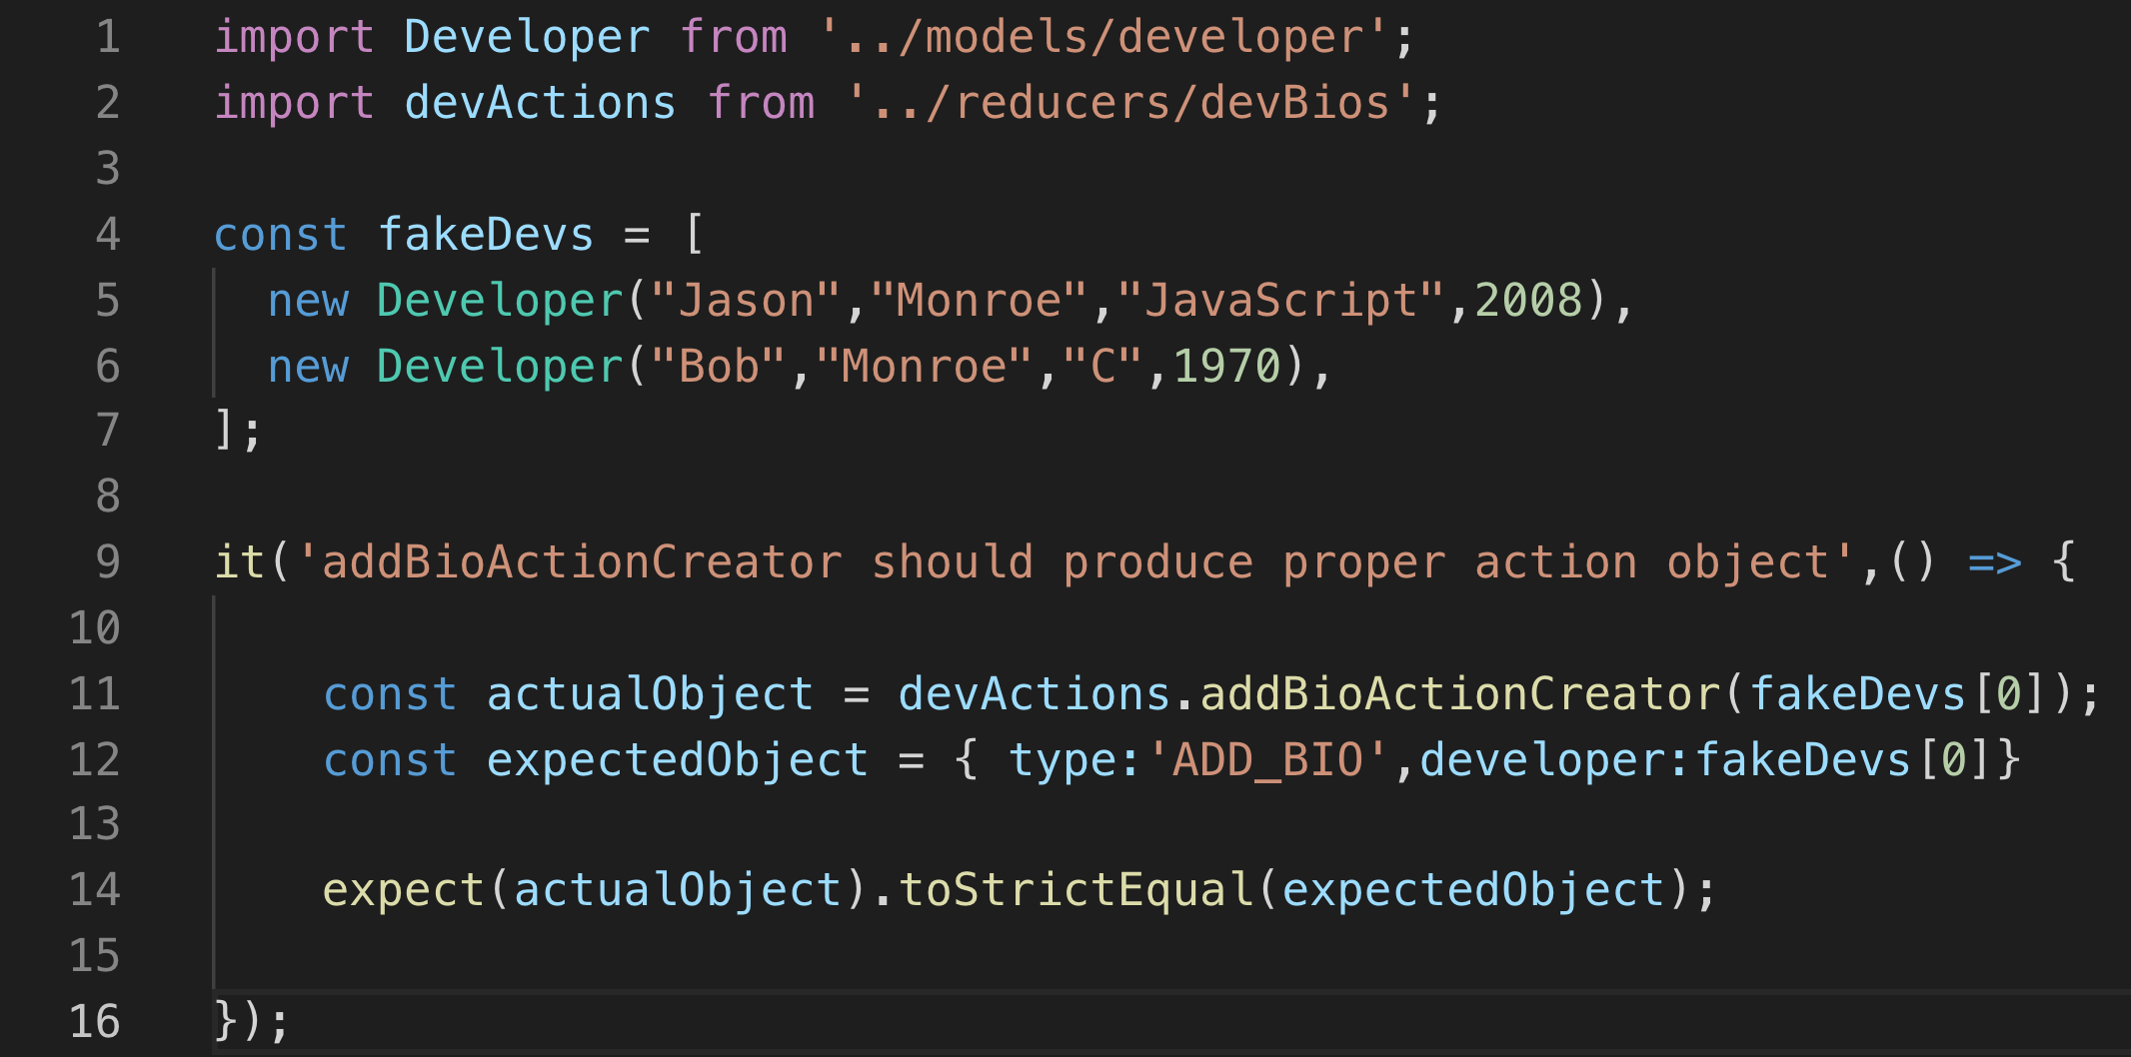
https://jsramblings.com/3-ways-to-test-mapstatetoprops-and-mapdispatchtoprops/

Slide 18
Testing Resource Appendix

Slide 19
Testing Basics
https://reactjs.org/docs/testing.html
https://medium.com/@rossbulat/testing-in-react-with-jest-and-enzyme-an-introduction-99ce047dfcf8
https://testing-library.com/docs/dom-testing-library/api-queries

Slide 20
Alternative library Enzyme
https://testdriven.io/blog/tdd-with-react-jest-and-enzyme-part-one/

Slide 21
Testing Redux
https://jsramblings.com/3-ways-to-test-mapstatetoprops-and-mapdispatchtoprops/

Slide 22
Thank You Jason Monroe 688776

